Slide 1
In- and out-of-sample predictability of MSCI Barra crowding factors
Cindy Lu

Slide 2
Motivation & Research Question
Based on Barra MSCI analysts’ approach to factor investing
Their factor crowding “model” examines crowding from multiple dimensions using a range of metrics: value spreads, short interest spreads, pairwise correlations, and relative volatility
Find that crowded factors had a much higher frequency of downturns in factor performance in the following 12 months than uncrowded factors
Considered 2 factors inspired by this “model”
Goal: statistically determine how well we predict future FF factor returns using past returns of the same FF factor (SMB & HML), and the crowding measures

Slide 3
The 2 Crowding Factors considered
Pairwise correlation
How top quintile and bottom quintile stocks of a factor (here is value) move relative to each other
For each stock the top value quintile, compute correlation of this asset’s return with the average return of all other stocks excluding this asset over last 63 days
Repeat the same for bottom quintile, for each month from 1963 June - 2020 December
Then take mean of top quintile correlations - mean of bottom quintile correlations
Valuation spread
Large amounts of capital following securities will result in them being more expensive than others
The degree to which top quintile stocks of a factor are expensive relative to bottom quintile (here factor is BM ratio)
For the BM ratio, the formula each month is log(median BM in bottom size quintile / median BM in top size quintile)

Slide 4
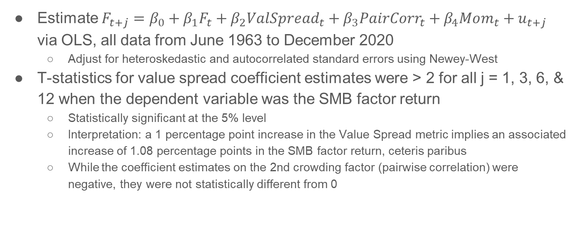
In-Sample Results, Summary
Estimate $F_{t+j}={β_{0}+β_{1}F}_{t}+β_{2}V{alSpread}_{t}+β_{3}{PairCorr}_{t}+β_{4}Mom_{t}+u_{t+j}$ via OLS, all data from June 1963 to December 2020
Adjust for heteroskedastic and autocorrelated standard errors using Newey-West
T-statistics for value spread coefficient estimates were > 2 for all j = 1, 3, 6, & 12 when the dependent variable was the SMB factor return
Statistically significant at the 5% level
Interpretation: a 1 percentage point increase in the Value Spread metric implies an associated increase of 1.08 percentage points in the SMB factor return, ceteris paribus
While the coefficient estimates on the 2nd crowding factor (pairwise correlation) were negative, they were not statistically different from 0

Slide 5
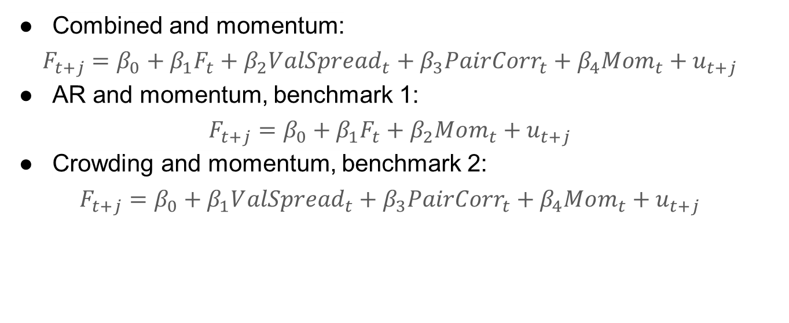
Out-of-Sample Model Formulations
Combined and momentum:
$$F_{t+j}={β_{0}+β_{1}F}_{t}+β_{2}V{alSpread}_{t}+β_{3}{PairCorr}_{t}+β_{4}Mom_{t}+u_{t+j}$$
AR and momentum, benchmark 1:
$$F_{t+j}={β_{0}+β_{1}F}_{t}+β_{2}Mom_{t}+u_{t+j}$$
Crowding and momentum, benchmark 2:
$$F_{t+j}=β_{0}+β_{1}V{alSpread}_{t}+β_{3}{PairCorr}_{t}+β_{4}Mom_{t}+u_{t+j}$$

Slide 6
Out-of-Sample Results - MSFE Ratios
Factor | Ratios | j=1 | j=3 | j=6 | j=12
HML | MSFE(combined)/MSFE(AR) | 0.3232 | 0.7602 | 0.8405 | 0.3683
 | MSFE(combined)/MSFE(crowd) | 0.5730 | 1.1230 | 0.9424 | 0.4346
SMB | MSFE(combined)/MSFE(AR) | 0.5324 | 0.4664 | 0.9843 | 0.7336
 | MSFE(combined)/MSFE(crowd) | 0.3397 | 0.4699 | 0.2787 | 0.3461

Slide 7
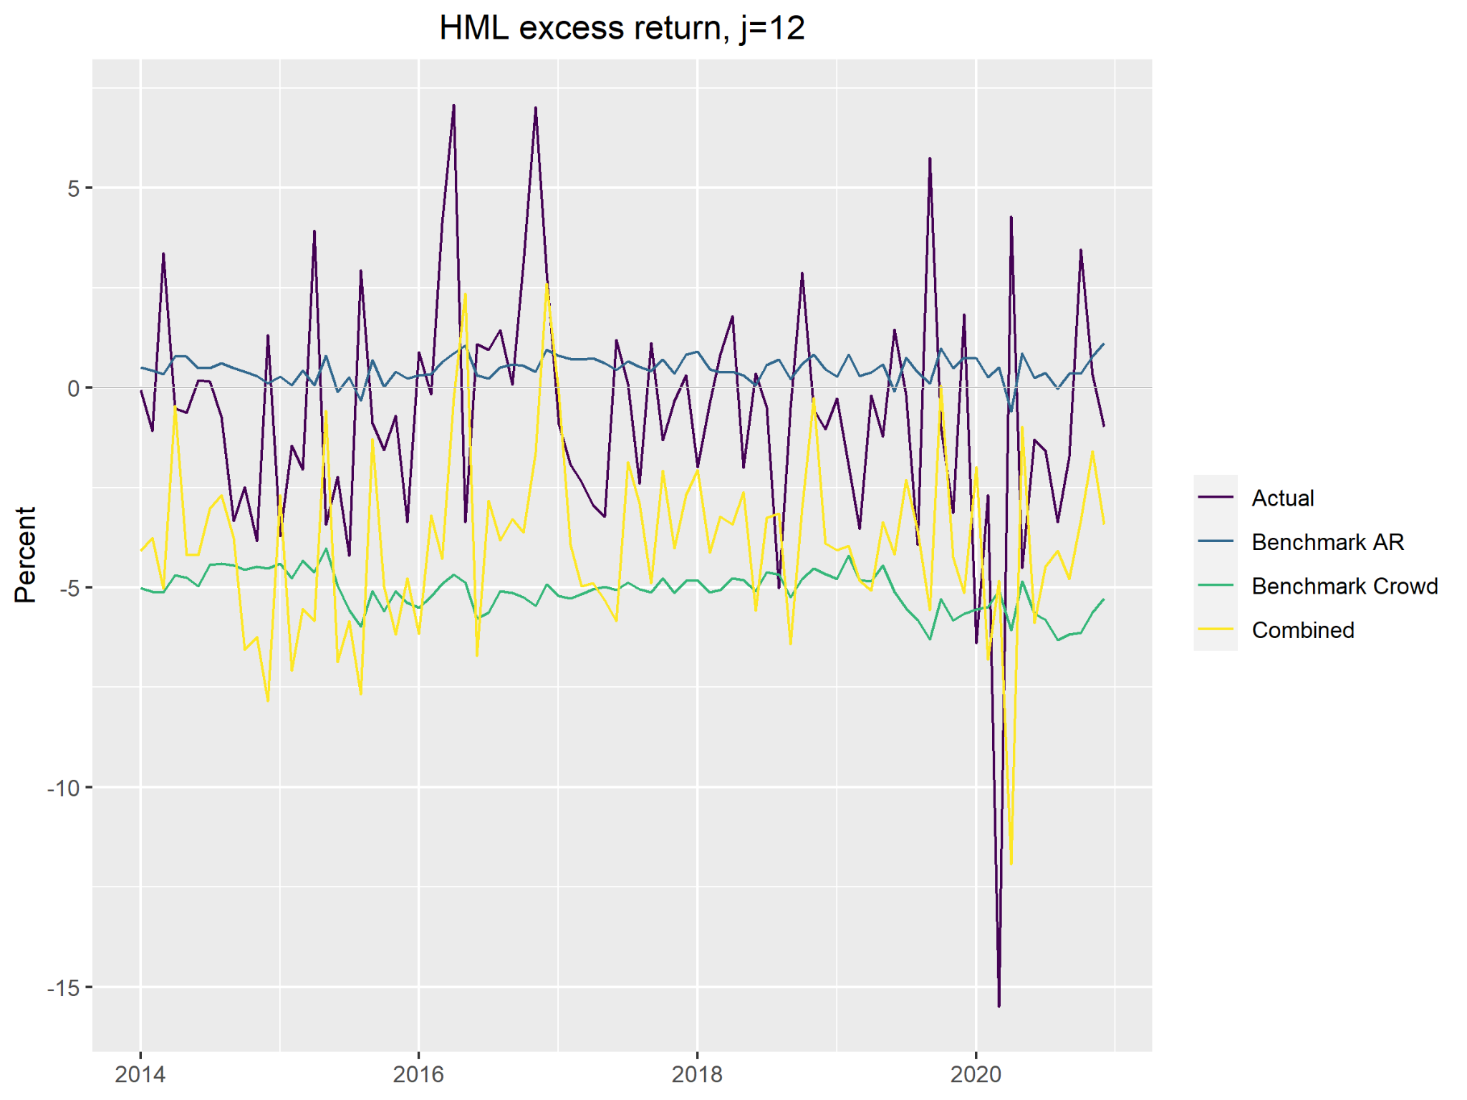
A Simulated Forecast plot, j = 12, HML

Slide 8
Future research directions
Investigate the rest of the crowding factors, especially short interest spread
Short interest utilization rate: Shares shorted / available shares to short
Heaving shorts in the bottom quintile relative to top creates high short interest crowding score
Constructed by regressing short interest utilization rate on a set of quintile dummy indicator variables for the factor of interest and size, value and momentum factors
Relation with Short interest index proposed by Rapach et. al. (2016)
Outperforms a host of popular return predictors both in and out of sample
Annual R2 statistics of 12.89% and 13.24%, respectively.
VAR decomp: economically short interest’s predictive power stems predominantly from a cash flow channel. Short sellers are informed traders who can anticipate future aggregate cash flows and associated market returns.

Slide 9
References
David E. Rapach; Matthew Ringgenberg and Guofu Zhou, (2016), Short interest and aggregate stock returns, Journal of Financial Economics, 121, (1), 46-65
Bonne, G., Roisenberg, L., Kouzmenko, R., & Zangari, P. (2018, June 1). MSCI INTEGRATED FACTOR CROWDING MODEL Assessing Crowding Risks in Equity Factor Strategies. https://www.msci.com/documents/10199/Acf506d5-4254-B85f-E213-Eaef95661970. https://www.msci.com/
https://christophscheuch.github.io/post/asset-pricing/fama-french-3-factors/

Slide 10
Appendix A1: In-sample Regression results, SMB j=1
Regressor | Betas | NW Std. Error | T-stats
Intercept | -0.40779006 | 0.41165600 | 0.9906088
SMB lag | 0.06422623 | 0.03868555 | 1.6602124
Value Spread | 1.08067629 | 0.43509726 | 2.4837580
Pairwise Correlation | 0.15964767 | 1.13661210 | 0.1404592
UMD | -3.54976179 | 2.98541657 | 1.1890340

Slide 11
Appendix A2: In-sample Regression results, HML j=1
Regressor | Betas | NW Std. Error | T-stats
Intercept | 0.65777644 | 0.3907277 | 1.6834651
HML lag | 0.05964091 | 0.0392250 | 1.5204818
Value Spread | -0.12421738 | 0.4077705 | 0.3046258
Pairwise Correlation | -1.21865478 | 1.0754103 | 1.1331998
UMD | -4.80948725 | 2.8607002 | 1.6812273

Slide 12
Appendix A3: In-sample Regression results, SMB j=3
Regressor | Betas | NW Std. Error | T-stats
Intercept | -0.39461035 | 0.42914988 | 0.9195164
SMB lag | -0.08959038 | 0.04989188 | 1.7956906
Value Spread | 1.12726044 | 0.46741201 | 2.4117062
Pairwise Correlation | 0.19130777 | 1.20908375 | 0.1582254
UMD | -3.20064662 | 3.42986481 | 0.9331699

Slide 13
Appendix A4: In-sample Regression results, HML j=3
Regressor | Betas | NW Std. Error | T-stats
Intercept | 0.61873548 | 0.39864850 | 1.5520828
HML lag | 0.05244545 | 0.06928484 | 0.7569542
Value Spread | -0.15074327 | 0.46117346 | 0.3268689
Pairwise Correlation | -1.14865038 | 1.07731121 | 1.0662196
UMD | 1.12245190 | 4.24728058 | 0.2642754

Slide 14
Appendix A5: In-sample Regression results, SMB j=6
Regressor | Betas | NW Std. Error | T-stats
Intercept | -0.14175669 | 0.43256247 | 0.32771380
SMB lag | 0.04240036 | 0.04152219 | 1.02114955
Value Spread | 1.46905676 | 0.44987213 | 3.26549850
Pairwise Correlation | -1.58585296 | 1.18315675 | 1.34035744
UMD | -0.08902138 | 3.94148922 | 0.02258572

Slide 15
Appendix A6: In-sample Regression results, HML j=6
Regressor | Betas | NW Std. Error | T-stats
Intercept | 0.513344054 | 0.44326879 | 1.1580875
HML lag | -0.007235108 | 0.04988559 | 0.1450340
Value Spread | 0.136445108 | 0.47017661 | 0.2901997
Pairwise Correlation | -1.380572596 | 1.20786120 | 1.1429894
UMD | 0.832827021 | 3.49258614 | 0.2384557

Slide 16
Appendix A7: In-sample Regression results, SMB j=12
Regressor | Betas | NW Std. Error | T-stats
Intercept | 0.32783240 | 0.45260821 | 0.7243183
SMB lag | 0.08819245 | 0.04081522 | 2.1607739
Value Spread | 0.90949453 | 0.40337914 | 2.2546891
Pairwise Correlation | -1.93020703 | 1.27115336 | 1.5184691
UMD | -2.87803809 | 3.38139140 | 0.8511402

Slide 17
Appendix A8: In-sample Regression results, HML j=12
Regressor | Betas | NW Std. Error | T-stats
Intercept | 0.36347509 | 0.37567003 | 0.9675382
HML lag | 0.03070014 | 0.05684051 | 0.5401102
Value Spread | 0.46166579 | 0.44981830 | 1.0263384
Pairwise Correlation | -1.48119469 | 1.05971283 | 1.3977321
UMD | -5.80628793 | -4.23746938 | 1.3702253

Slide 18
Appendix B: MSFE estimation via Pseudo OOS Forecast
Pseudo OOS Forecasts to estimate MSFE:
Choose last P observations, put s = T-P initially
Estimate forecasting model using first s observations
Compute forecast for s+j regressor
Compute forecast error for s+j
Then repeat for remaining periods
Take the sum of squared errors and average over P

Slide 19
Appendix C: Data & FF-factors Replication
Merging Compustat & CRSP: using linkfile
Make sure links are valid, so data date is between link end date and link start date
Merge on date and PERMNO
When computing BM ratio make sure that the market cap is from current year’s June, market equity is from end of previous year, and book equity data is from the previous year.
They can differ up to 11 months since companies’ fiscal year ends are not uniform and they do not release this information at the same time
Market cap from year y is used to construct value-weighted returns until May of next year
List of correlations
HML: 0.93
UMD: 0.9994
SMB: 0.96
MKT: 0.99

